Slide 1

Pac-Man
A.I – CMPS453
By: Ibrahim Abou Zahr

Slide 2

What is Pac-Man?
Pac-Man is an iconic arcade game developed by Namco and was released in 1980.
Pac-Man is cited as the highest grossing arcade game of all time. Generating $2.5 billion in quarters by the 1990s.
The highest score ever in Pac-Man was set in 1999 by Billy Mitchell, who achieved a score of 3,333,360 points by eating every fruit and ghost on each of the game's 255 levels without losing a single life.
The AI controlling the behavior of the ghosts in Pac-Man is one of the most fascinating aspects of the game.

Slide 3


Problem Description
Pac-Man: The player/user takes control of a yellow circular character whose objective is to consume all pellets in the maze. The player can move in 4 directions: up, down, left and right.
Maze: The game takes place in a maze consisting of walls and pellets. Maze layout varies between levels.
Ghosts: They are the main antagonists in Pac-Man. They roam the maze and chase the player in an attempt to catch and kill him.
Pellets: Small pellets are scattered through the maze. The player must eat all of them to complete the level.
Fruits: When the player eats a fruit, the ghosts temporally become vulnerable to the player.
Game Over: The player starts with 3 lives. If a ghost catches Pac-Man he loses a life. The game ends when all lives are lost.

Slide 4
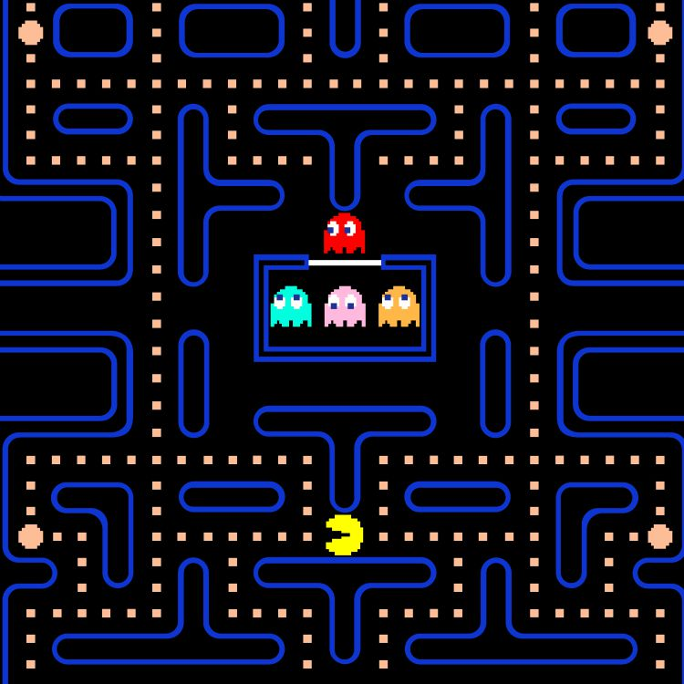
State Description
Pac-Man’s Position: Usually represented by coordinates (x,y) or grid indices.
Ghost Positions: They are also represented by coordinates or grid indices. Knowing the positions of the ghosts helps the player to avoid them.
Pellet Placement: They are placed in all corridors of the given level. Knowing where each pellet is helps the player progress in the game.
Level: Each level has a unique maze, and after finishing a level the player progresses to the new one.
Game Over: This status determines whether the game continues or requires restarting.

Slide 5
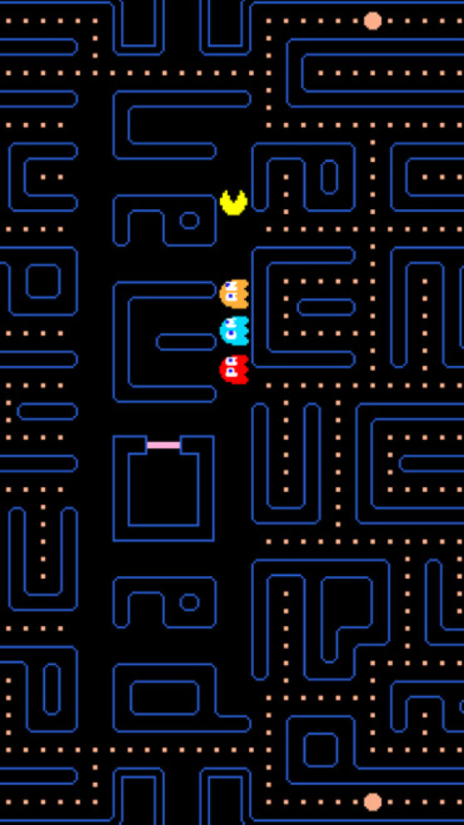
Initial Condition
Starting Position: Pac-Man starts the game near the center of the maze or in a specified starting area.
Ghosts Initial Positions: These placements may vary depending on the level and are positioned in their respective starting locations.
Pellet Location: At the start, all pellets are scattered throughout the whole maze.
Score: Initial score is set to 0.
Lives: Initially the player starts with 3 lives.
Fruit/Power Pellet: All randomly placed throughout the maze.

Slide 6

Goal State
All Pellets are Eaten: This is the main objective of the player which is consuming all pellets in the given level.
Remaining Lives: This can vary from one player to the other depending on how many times the player has been hit by ghosts.
Killing All Ghosts: This status is optional since Pac-Man can complete any level without defeating the ghosts as long as all pellets were consumed.

Slide 7
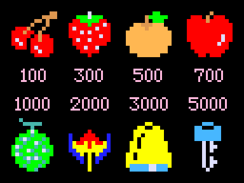
Successor Function
Legal Moves: Pac-Man can only move in 4 ways: up, down, left and right. However, if the player collided with a wall then such move is not legal.
New Moves: Every move a player makes in the game changes the current state of the game ( ghost positions, pellets located… etc.)
Check Goal State: After every move that Pac-Man makes, the game evaluates the current state with the goal state required to end the game.
Ghost Interaction: After a move the game should check if the player collided with any ghost to deduct one of the player’s lives.
Power Pellet: Check if the player’s position overlaps a fruit’s position to temporally empower the player.

Slide 8
Successor Example
Pacman moves right from (3,5) to (3,6)
Move Right!
Pacman moves left from (3,5) to (3,4)
Move Left!
Move Up!
Pacman moves up from (3,5) to (2,5)

Slide 9
State Recap
Pac-Man's Position: Player can move freely if the move was legal E.g. : (0,0) to (0,1)
Ghosts: They can occupy various positions based on their coordinates.
Maze Layout: The map is basically made up of a bunch of corridors and walls for players to walk in them.
Variables: Score, Lives, Pellets… are all changing depending on the successor states.

Slide 10
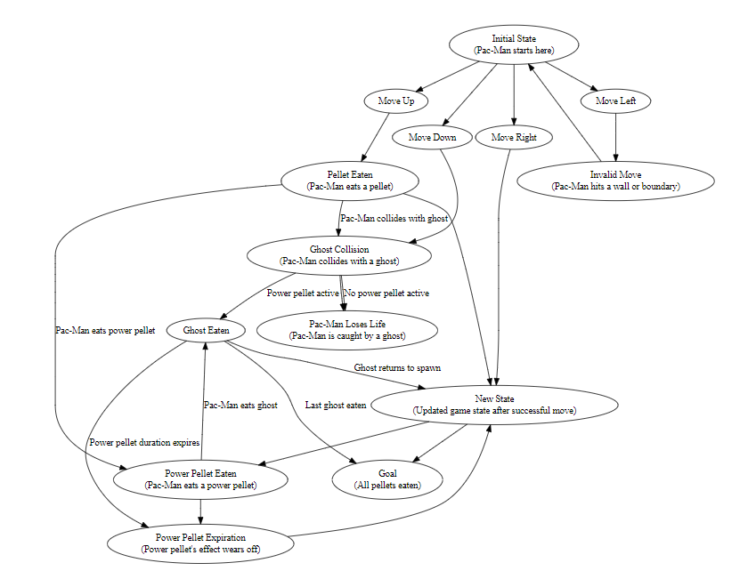
State Space

Slide 11
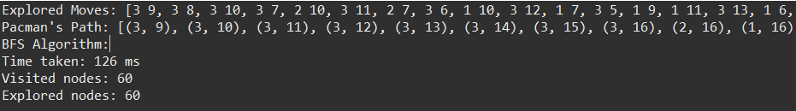
BFS Traversal
BFS is a way of traversing through a given graph or state space by going one level each time.

Slide 12
BFS STATE Traversal
State SPace
EXAMPLE
The algorithm traverses through level order, checks if left, right, up and down moves are valid and give a goal state.
After that, the system moves to the other level, one gives an invalid move, a new state, ghost collusion and pellet eaten.
Moreover, by reaching the final depth level, we’d have nodes: Power pellet eaten, Goal State, and New state. Therefore, goal state is reached.

Slide 13
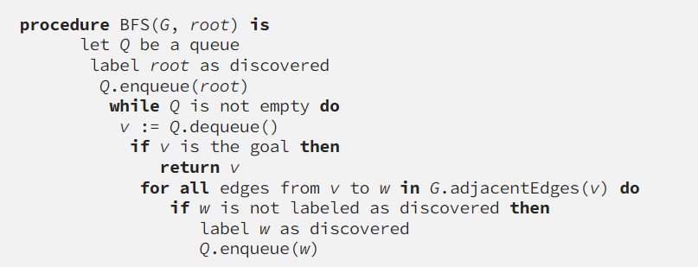
BFS Pseudo Code

Slide 14
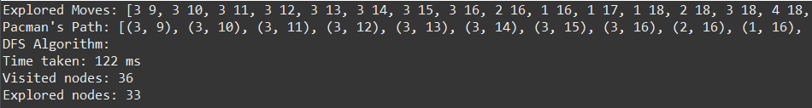
DFS Traversal
DFS is also another traversal technique that visits every node start from the left most branches (pre order traversal).

Slide 15
DFS State traversal
State Space
State Example
DFS is leftmost traversal, the search algorithm goes to the Move Up node and traverses left mostly down.
After that, Pellet eaten node is visited and power pellet node is also visited.
This process keeps taking place until the current node visited is the Goal state.

Slide 16
DFS Algorithm
The DFS algorithm initializes counters for visited and explored nodes. It iterates through a stack of agents until it's empty, popping each one and marking its move as explored while incrementing the count of explored nodes. If the current agent reaches the goal state, it prints the explored moves and the path to reach the goal before returning. If not at the goal state, it generates next possible agents based on available actions and pushes valid ones onto the stack. In the main function, it starts a timer, reads input, creates an initial agent, performs the search, stops the timer, and prints the total execution time along with the counts of visited and explored nodes.

Slide 17
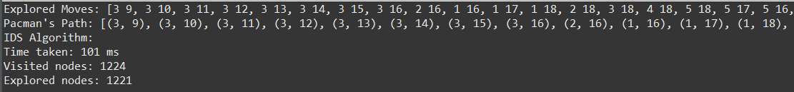
IDS Algorithm
IDS is a search algorithm that combines DFS and BFS. It’s mainly used when the depth space is unknown and is very large.

Slide 18
IDS State traversal
State Space
State Example
IDS combines both BFS and DFS. Therefore, it goes through iterations through the game. Moreover, this traversal goes through Move up node and explores it, checks if it’s the goal state or not. If not, it goes through another iteration down another level which in this example is the pellet eaten node.

Slide 19
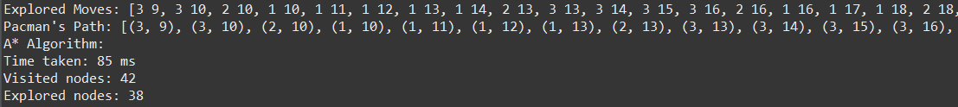
A* Algorithm
This traversal search is efficient in pathfinding and graph traversal. It’s an extension of Dijkstra’s (UCS) algorithm with a heuristic function used to guide the search.

Slide 20
A* State traversal
State Space
State Example
In this example, the heuristic function is calculated and the cost is given. Since the cost is the same, it all depends on the heuristic function. For instance, the Move Right node has the lowest heuristic which is why we traverse to it. Moreover, we enqueue the new node explored and calculate the heuristic function for it and compare.

Slide 21
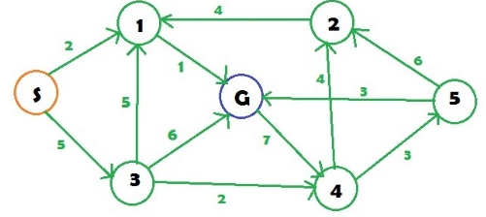
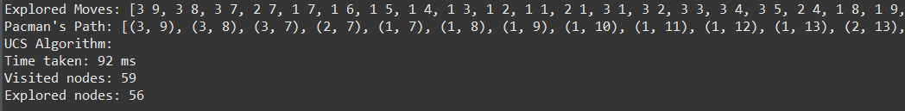
UCS Traversal
UCS is a traversal algorithm that tries to find the path with the lowest cost possible and it’s an uninformed type search.

Slide 22
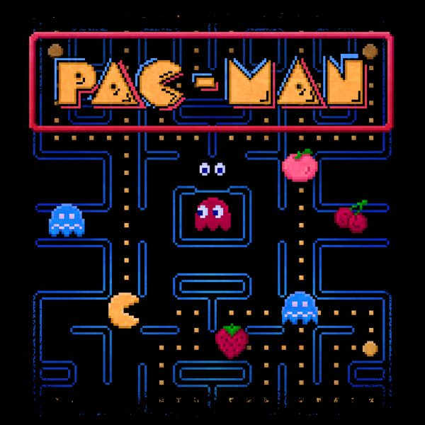
Algorithm Comparisons

Slide 23

Conclusion
This project made exploring various search techniques on an iconic game possible and interesting to indulge in which provided valuable insights behind how AI operates especially in a gaming context!

